Slide 1
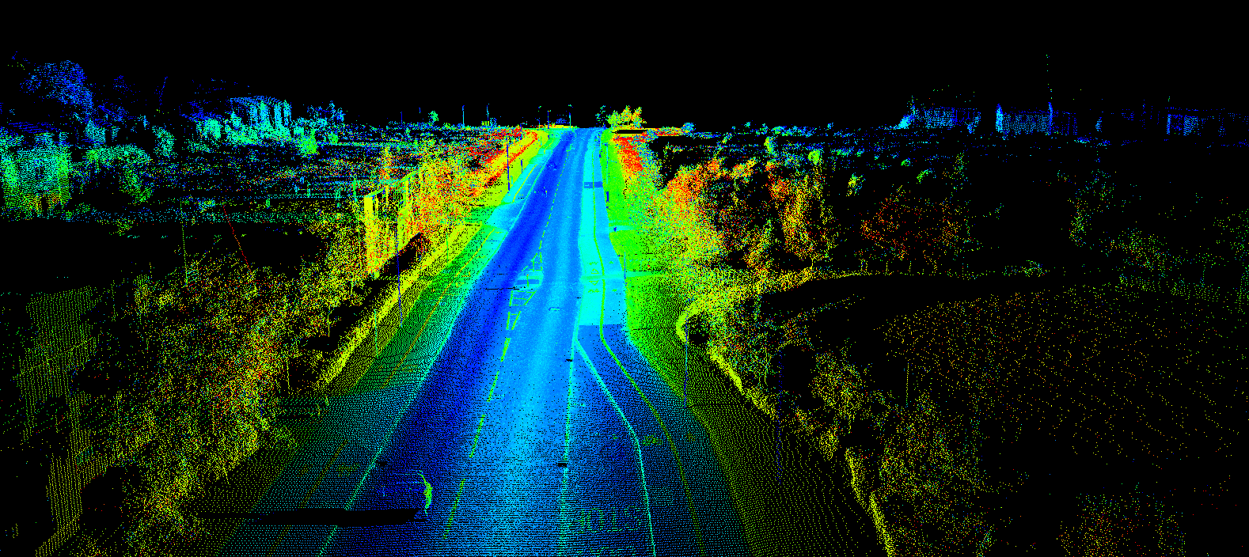
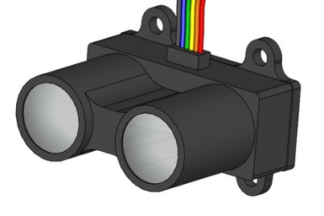
LiDAR Based Real-time 3D Surveillance System
Supervised by
Dr. Mohamed El-Sharkawy
Professor
Dept. of ECE, IUPUI
Date : December 06, 2017
Presented by
Abhinaba Bhattacharjee
Md Saiful Islam
Prodipto Chowdhury

Slide 2
Outlines Of Presentation
Introduction
Project Overview
System Implementation
System Functioning
System Calibration
Geometric Transformation
Challenges Faced
Conclusion & Future Work
References

Slide 3
Introduction
Existing surveillance systems (camera, CCTV) produce two dimensional images.
Depth of objects in images cannot be estimated accurately.
Localization and mapping is very difficult using a single vision camera.
LiDAR generates three dimensional data.
Can be an improvement over current surveillance systems.

Slide 4
Project Overview
Generating a real-time 3D environmental map using sensor fusion of a LiDAR and an Inertial Measurement Unit.
LiDAR is mounted on a 360 degree rotating structure along with tilt facilitated by a Servo mechanism to map points on the spherical coordinate system.
Real-time 3D map has been used to localize points of interest in point cloud and upload their coordinates to Internet Cloud via Wi-Fi.

Slide 5
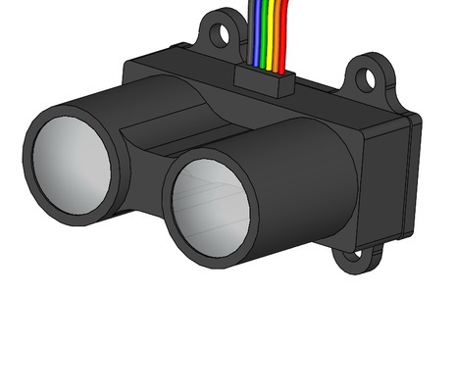
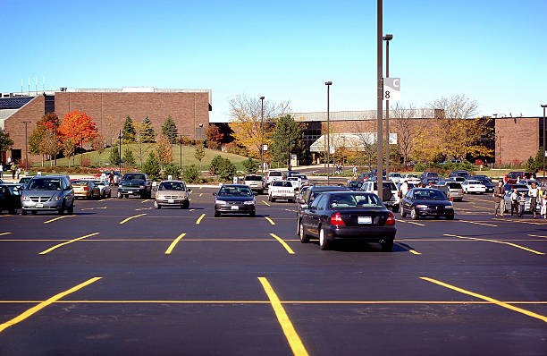
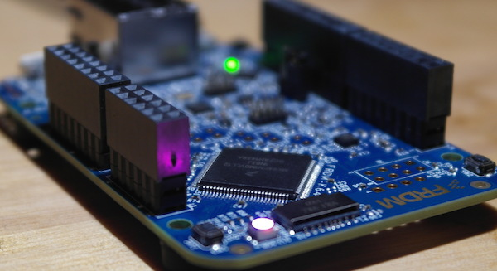


Project Overview

Slide 6
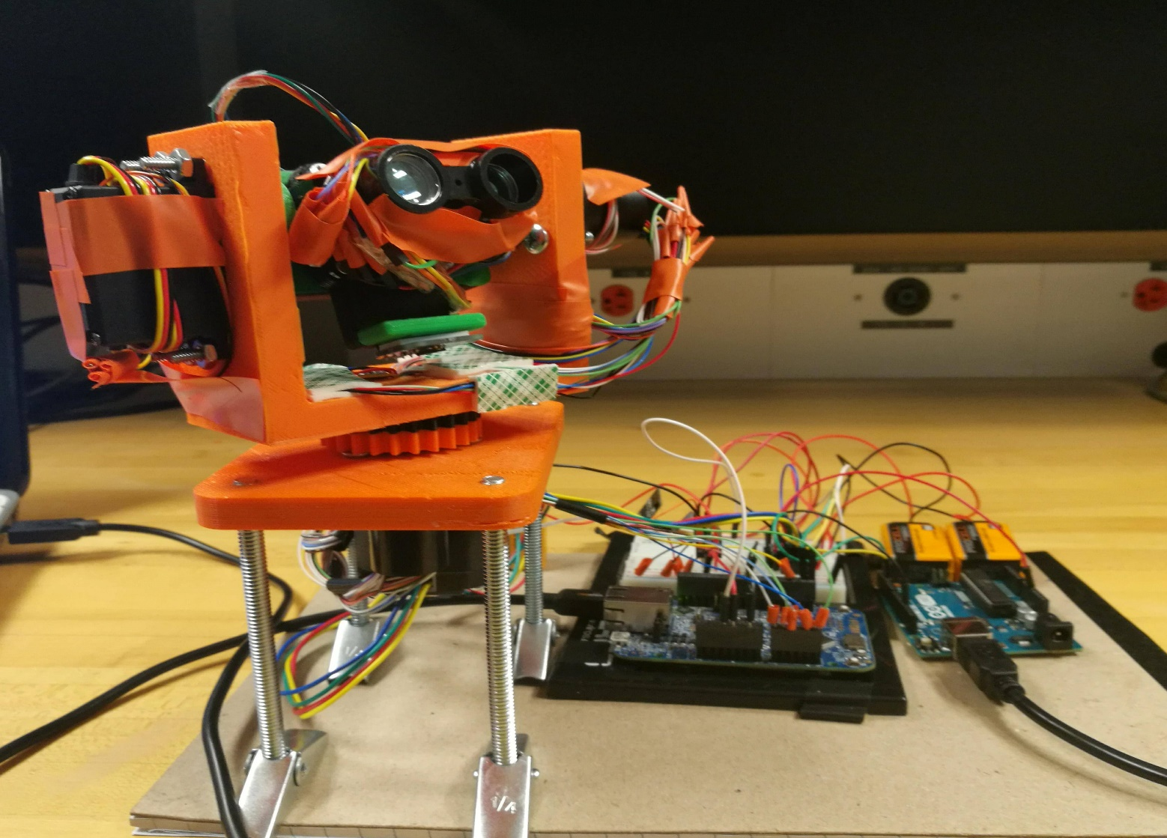
Project Overview

Slide 7
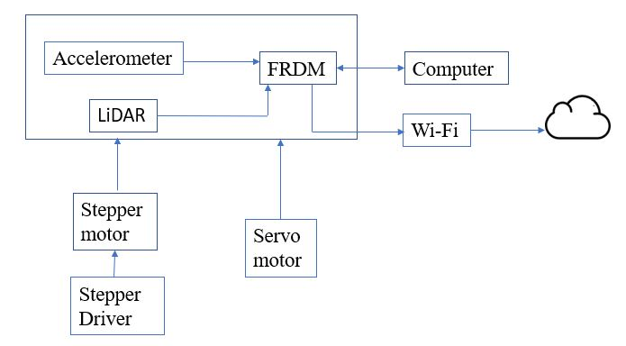
System Implementation
Sensor unit
DAC
Microprocessor Unit
Serial com
3D Mapping in PC
WiFi
Cloud

Slide 8
System Implementation
Mechanical framework
Electrical Assembly
Software development tools

Slide 9
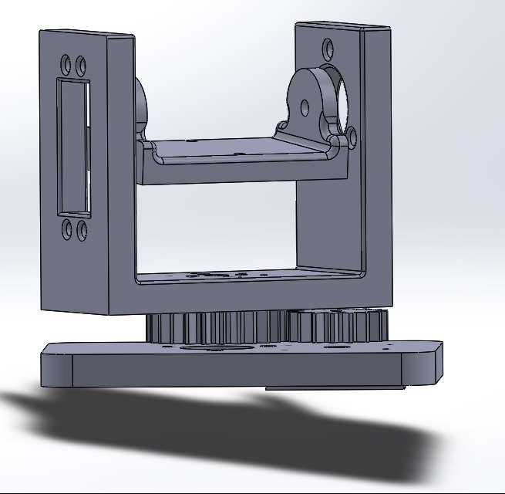
Mechanical Framework
The LIDAR-Lite is mounted on the stepper motor and rotated using servo motor. The individual components of mechanical design were computer modelled and 3D printed.

Slide 10
Electrical Assembly
LiDAR lite V3
ADXL335 accelerometer
FRDM K64F Microcontroller
ESP8266 Wi-Fi module
NEMA geared stepper motor
Tower Pro MG995 Servo motor
A4988 Stepper Driver
Slip ring

Slide 11
Software Development Tools
Mbed Online
Visual Python
PHP

Slide 12
System Functioning
Sensor Unit:
ADXL335 accelerometer detect changes in force resulting from tilt and gives x,y,z value.
LiDAR lite V3 gives us depth measurement.
Microprocessor Unit
After acquisition of sensor data FRDM K64F Microcontroller transforms data using mathematical rule for rotation of axis
It also helps Wi-Fi module to send data to cloud.

Slide 13
System Functioning
3D Mapping Unit:
It maps processed and transformed data from microprocessor unit and generate a 3D point cloud.

Slide 14
System Calibration
ADXL335 accelerometer scaling
360 degree continuous rotational servo motor calibration
Stepper motor calibration

Slide 15
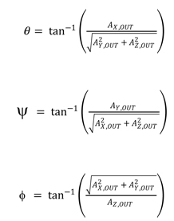
Geometric Transformation
Taking x,y,z value of accelerometer and depth measurement of LiDAR we use following mathematical transformation to generate 3D point cloud.

Slide 16
Challenges Faced
3D printing and stabilizing mechanical frame work
Scaling of accelerometer
Calibration of stepper and servo motor
Generating 3D point cloud using LiDAR

Slide 17
Conclusion And Future Work
The main idea is to generate a real-time 3D environmental map to localize points of interest in the point cloud and upload their coordinates to Internet Cloud via Wi-Fi.
In future, this real-time map can be used as live 3D footage of open space parking lots and hence utilized by autonomous cars to locate empty parking spots and generate a navigation path.

Slide 18
References
Q. Wu, K. Sun, W. Zhang, C. Huang, and X. Wu, “Visual and LiDAR-based for the mobile 3D mapping,” 2016 IEEE International Conference on Robotics and Biomimetics (ROBIO), 2016.
Strasdat, Hauke, J. M. M. Montiel, and Andrew J, “Davison,Scale drift-aware large scale monocular SLAM,” Robotics: Science and Systems VI , 2010
Y. He, L. Chen, J. Chen, and M. Li, “A novel way to organize 3D LiDAR point cloud as 2D depth map height map and surface normal map,” 2015 IEEE International Conference on Robotics and Biomimetics (ROBIO), 2015.Fast Segmentation of 3D Point Clouds: A Paradigm on LiDAR Data for Autonomous Vehicle Applications
3D-LIDAR based Branch Estimation and Intersection Location for Autonomous Vehicles
www.mbed.com
ECE533-Wireless and Multimedia Computing Lab Manual

Slide 19
Video

Slide 20
Question & Answer Session
Thanks for your patience.

